Slide 1
Recognizing the topology

Slide 2
Determining the Polarity of Feedback
1) Assume the input goes either up or down.
2) Follow the signal through the loop.
3) Determine whether the returned quantity enhances or opposes the original change.

Slide 3
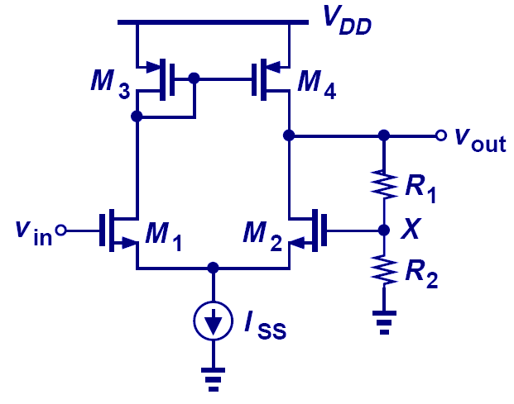
Polarity of Feedback Example I
Negative Feedback

Slide 4
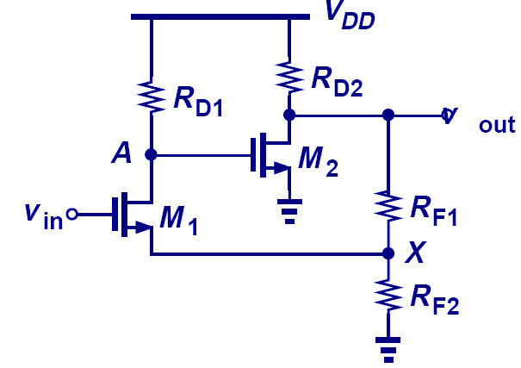
Polarity of Feedback Example II
Negative Feedback

Slide 5
Determining Feedback Topology

Slide 6
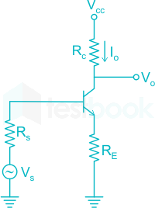
Example
In the following circuit find the feedback topology?

Slide 7
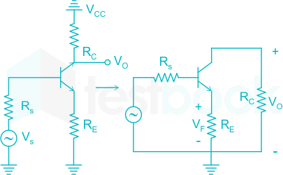
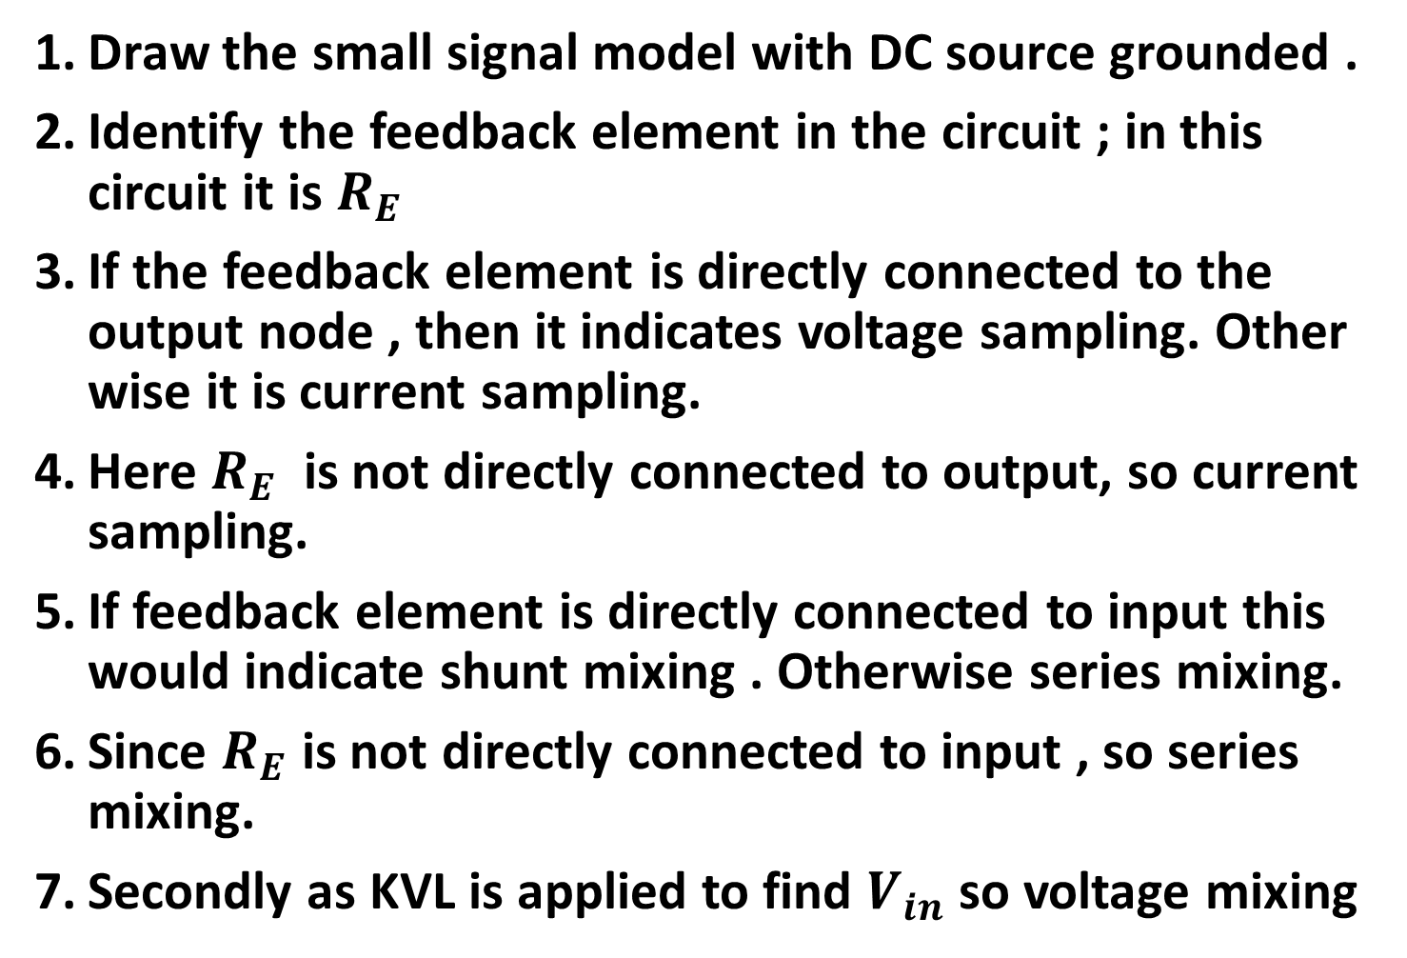
Steps:
Draw the small signal model with DC source grounded .
Identify the feedback element in the circuit ; in this circuit it is $R_{E}$
If the feedback element is directly connected to the output node , then it indicates voltage sampling. Other wise it is current sampling.
Here $R_{E}$ is not directly connected to output, so current sampling.
If feedback element is directly connected to input this would indicate shunt mixing . Otherwise series mixing.
Since $R_{E}$ is not directly connected to input , so series mixing.
Secondly as KVL is applied to find $V_{in}$ so voltage mixing
KVL

Slide 8
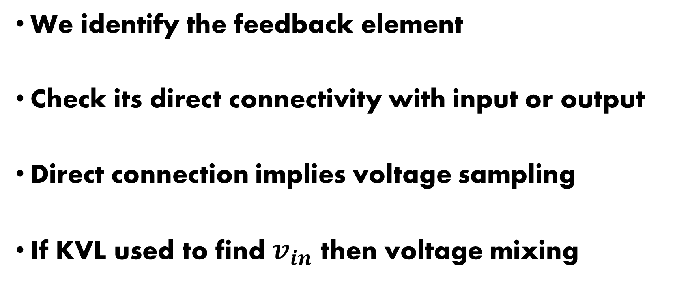
Conclusion
We identify the feedback element
Check its direct connectivity with input or output
Direct connection implies voltage sampling
If KVL used to find $v_{in}$ then voltage mixing

Slide 9
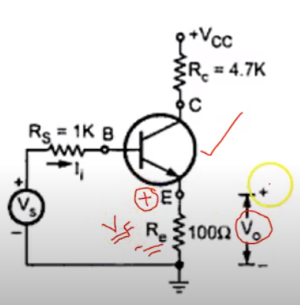
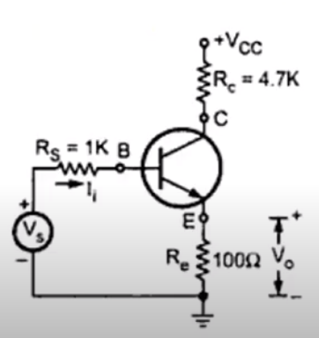
Emitter follower
Voltage sampling: output and the feedback at same node
We are applying KVL to achieve mixing; so series mixing ; if it was KCL then it would have been shunt mixing

Slide 10
Second Method
Short the output node- This will kill the output voltage and the feedback mechanism should die down if it is voltage sense. If it doesn't, then its a current sense.
Open the output node- This will kill the output current and thus any current sense feedback should die down.
At the input, it is pretty easy to determine the type of mixing- If it is voltage feedback, a subtraction of voltages would be involved. If it is a current feedback, a subtraction of currents would be involved.

Slide 11
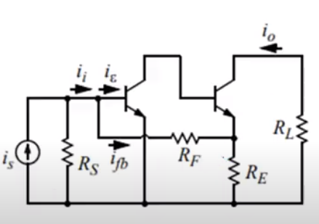
Current amplifier
Parallel – Series Topology
Current – Current
Feedback element directly connected to input so shunt mixing
Feedback and the output not connected at the same node so current feedback
We will have to apply KCL to find the input current so current mixing

Slide 12
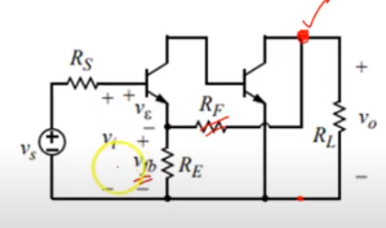
The output and feedback element at same node so voltage feedback
KVL may be applied to get input ,So voltage mixing

Slide 13
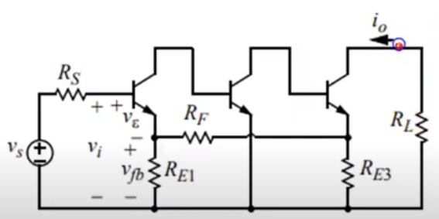
Output and feedback node not same so current feedback
KVL at input so voltage mixing

Slide 14
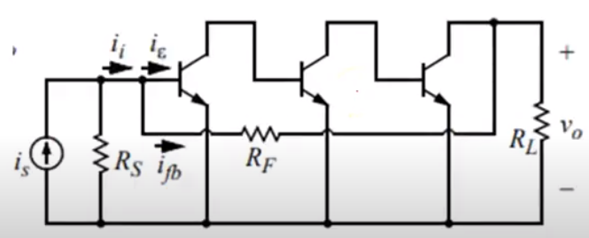
Output node and the feedback element at the same node so voltage sampling
KCL at the input so current mixing

Slide 15
Some more examples on recognizing feedback topology

Slide 16
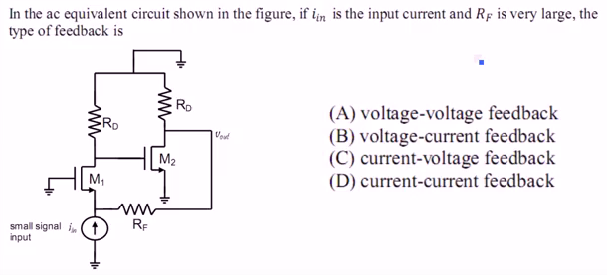
Output input

Slide 17
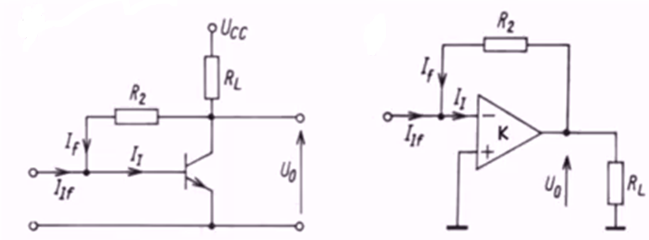
current mixing and voltage sampling

Slide 18
Stability: Lecture -1

Slide 19
Introduction
$$A_{f}=\frac{A}{1+Aβ}$$
The key feedback parameter are the loop gain (Aβ.), which for negative feedback must be a positive dimensionless number.
Since A and β are in general frequency dependent, the poles of the feedback amplifier are obtained by solving the characteristic equation 1+A(s)β(s) = 0.
For the feedback amplifier to be stable, its poles must all be in the left-hand side of the s-plane.

Slide 20
Introduction
1+A(s)β(s) = 0
Stability is guaranteed if at the frequency for which the phase angle of Aβ is 180^{O}, the |Aβ| is less than unity; the amount by which it is less than unity, expressed in decibels, is the gain margin.
Alternatively, the amplifier is stable if, at the frequency at which |Aβ| = 1, the phase angle is less than 180^{O}, the difference is the phase margin.

Slide 21
Introduction
To make a given amplifier stable for a given feedback factor β, the open-loop frequency response is suitably modified by a process known as frequency compensation.
A popular method for frequency compensation involves connecting a feedback capacitor across an inverting stage in the amplifier. This process is known as pole splitting.

Slide 22
Stability: Detailed analysis

Slide 27
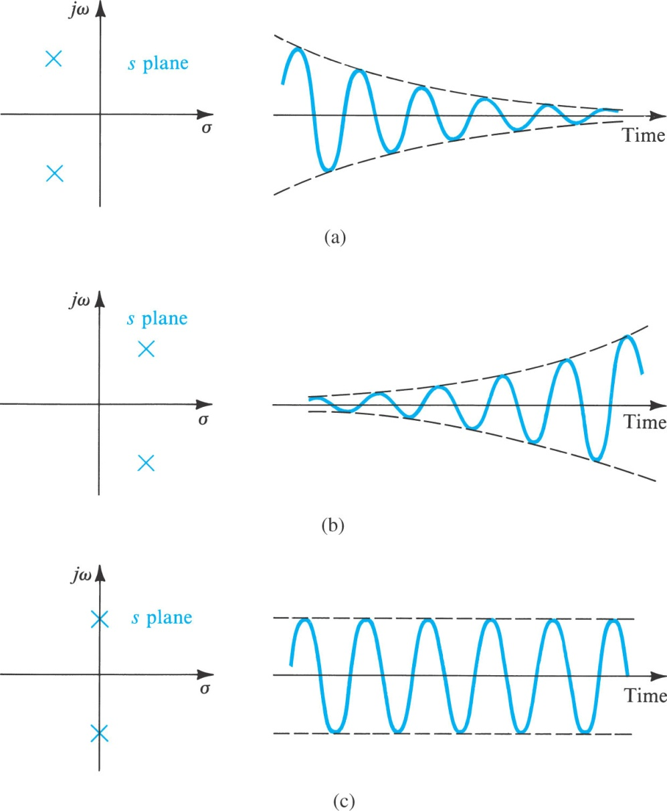
Effect of Feedback on the Amplifier Poles
Poles location in S plane
Time domain response

Slide 28
General methods for stability analysis

Slide 29
Sequence : Stability analysis
What is Bode Plot & how to plot it
Stability analysis using Bode plots
What is root locus
Stability analysis using root locus
Routh criteria and stability analysis using this criteria
Nyquist stability criteria

Slide 30
Nyquist Plot & Bode Plot
Frequency response can be determine by methods that includes Bode' plots and Nyquist plots.
Bode' plots use frequency as the horizontal axis and use two separate plots to display amplitude and phase of the frequency response.
Nyquist plots display both amplitude and phase angle on a single plot, using frequency as a parameter in the plot.
Nyquist plots have properties that allow you to see whether a system is stable or unstable.

Slide 31
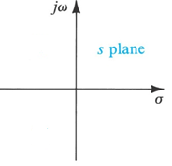
Root Locus
Root locus is a graphical representation of the closed-loop poles as a system parameter is varied
Definition：
The path traced by the roots of the characteristic equation of the closed-loop system as the gain K is varied from 0 to +∞ is called root locus.
By using root locus method, we can：
Analyze the performance of the system
Determine the structure and parameter of the system
Design the compensator for control system,

Slide 32
Bode Plot Review

Slide 33
What is Bode Plot
It is graphical representation of transfer function to find out the stability of control system and perform frequency analysis.
It consists of two plots
Magnitude (in dB) Vs frequency plot
Phase angle Vs frequency plot

Slide 34
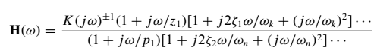
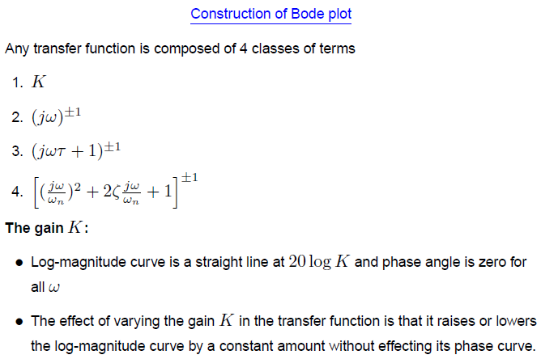
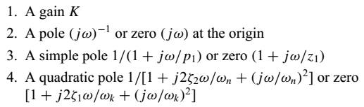
Classes of Terms in TF

Slide 35
First class of term of TF
Bode plot of constant gain term
Magnitude vs ῳ
Phase vs ῳ

Slide 36
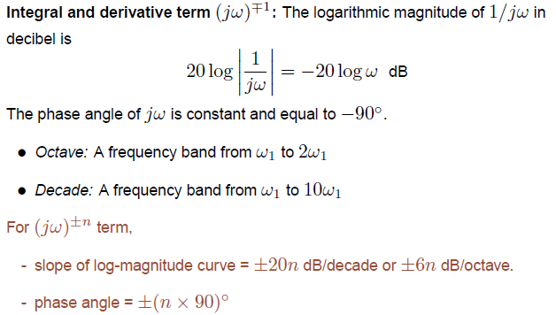
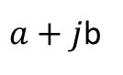
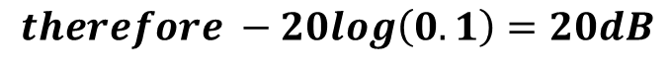
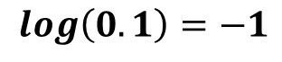
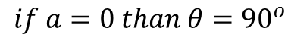
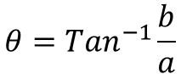
Second class of term (Also called integral /Derivative term)
1/jω is a pure integrator and jω is pure differentiator
$$log\left(0.1\right)=−1$$
$$therefore −20log\left(0.1\right)=20dB$$
$a+j$b
$$θ={Tan}^{−1}\frac{b}{a}$$
$$if a=0 than θ={90}^{o}$$

Slide 37
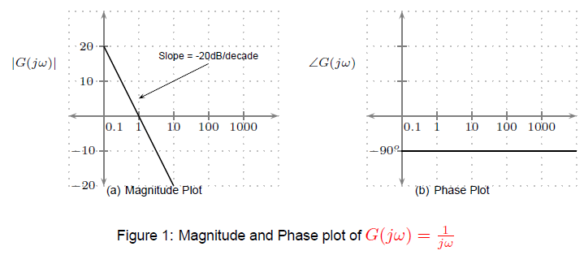
This axis drawn is not at 0 radian but at 0.1 radian
Pole /integral term (1/S)

Slide 38
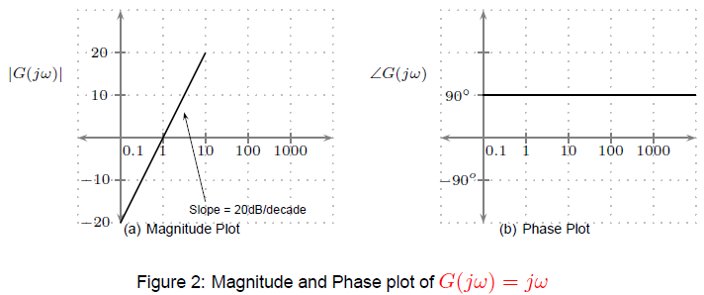
Zero /derivative term (S)

Slide 39
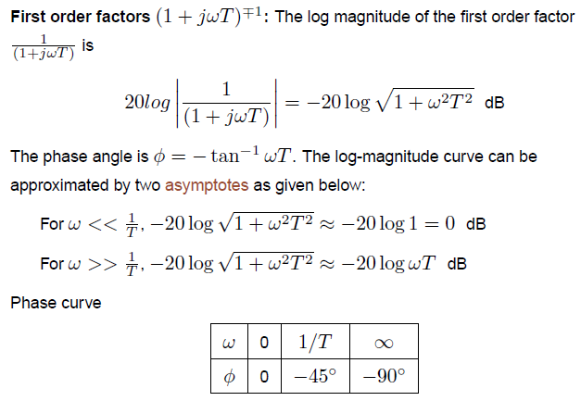
Third class of term of TF

Slide 40
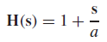
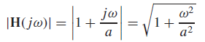
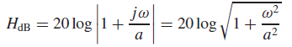
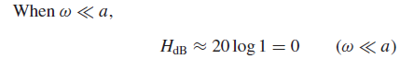
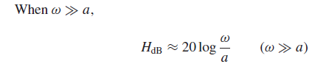
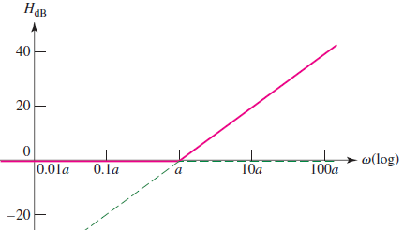
Recall Book’s Example
Note that the two asymptotes intersect at ω = a, the frequency of the zero. This frequency is also described as the corner, break, 3 dB, or half-power frequency.

Slide 41
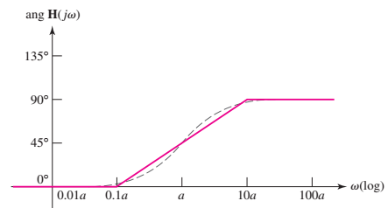
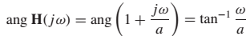
Phase

Slide 42
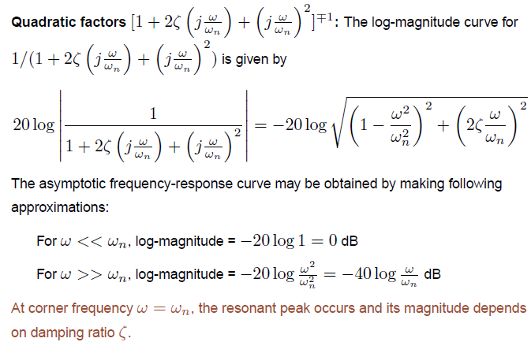
Fourth class of term of TF

Slide 43
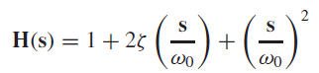
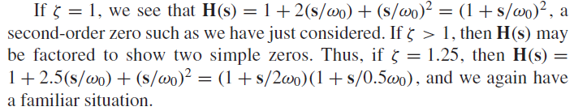
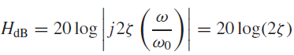
Quadratic Transfer Function
At corner frequency
Keep this in mind for future calculations

Slide 44
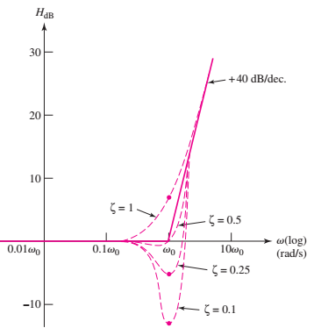
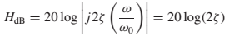
However, a correction must be applied in the neighborhood of the corner frequency
If ζ = 1, a limiting case, the correction is +6 dB; for ζ = 0.5, no correction is required; and if ζ = 0.1, the correction is −14 dB. Knowing this one correction value is often sufficient to draw a satisfactory asymptotic magnitude response

Slide 45
Phase Response
At the corner frequency

Slide 46
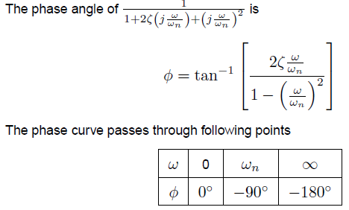

Slide 47
Bode :Example
Consider the following transfer function
Break frequencies: invert time constants

Slide 48
Breaking Down the Magnitude
Recall log of products is sum of logs
Let’s plot each factor separately and add them graphically

Slide 49
Breaking Down the Phase
Since
Let’s plot each factor separately and add them graphically

Slide 50
Magnitude Bode Plot:
First Zero
80
60
40
20
0 dB
10⁴
10⁵
10⁶
10⁷
10⁸
10⁹
10¹⁰
10¹¹
-20
-40
-60
-80

Slide 51
Phase Bode Plot:
180
135
90
45
10⁴
10⁵
10⁶
10⁷
10⁸
10⁹
10¹⁰
10¹¹
-45
-90
-135
-180

Slide 52
Magnitude Bode Plot: Add First Pole
80
60
40
20
10⁴
10⁵
10⁶
10⁷
10⁸
10⁹
10¹⁰
10¹¹
-20
-40
-60
-80

Slide 53
Phase Bode Plot: Add First Pole
180
135
90
45
10⁴
10⁵
10⁶
10⁷
10⁸
10⁹
10¹⁰
10¹¹
-45
-90
-135
-180

Slide 54
Magnitude Bode Plot: Add 2nd Zero
80
60
40
20
10⁴
10⁵
10⁶
10⁷
10⁸
10⁹
10¹⁰
10¹¹
-20
-40
-60
-80

Slide 55
Phase Bode Plot: Add 2nd Zero
180
135
90
45
10⁴
10⁵
10⁶
10⁷
10⁸
10⁹
10¹⁰
10¹¹
-45
-90
-135
-180

Slide 56
Magnitude Bode Plot: Add 2nd Pole
80
60
40
20
10⁴
10⁵
10⁶
10⁷
10⁸
10⁹
10¹⁰
10¹¹
-20
-40
-60
-80

Slide 57
Phase Bode Plot: Add 2nd Pole
180
135
90
45
10⁴
10⁵
10⁶
10⁷
10⁸
10⁹
10¹⁰
10¹¹
-45
-90
-135
-180

Slide 58
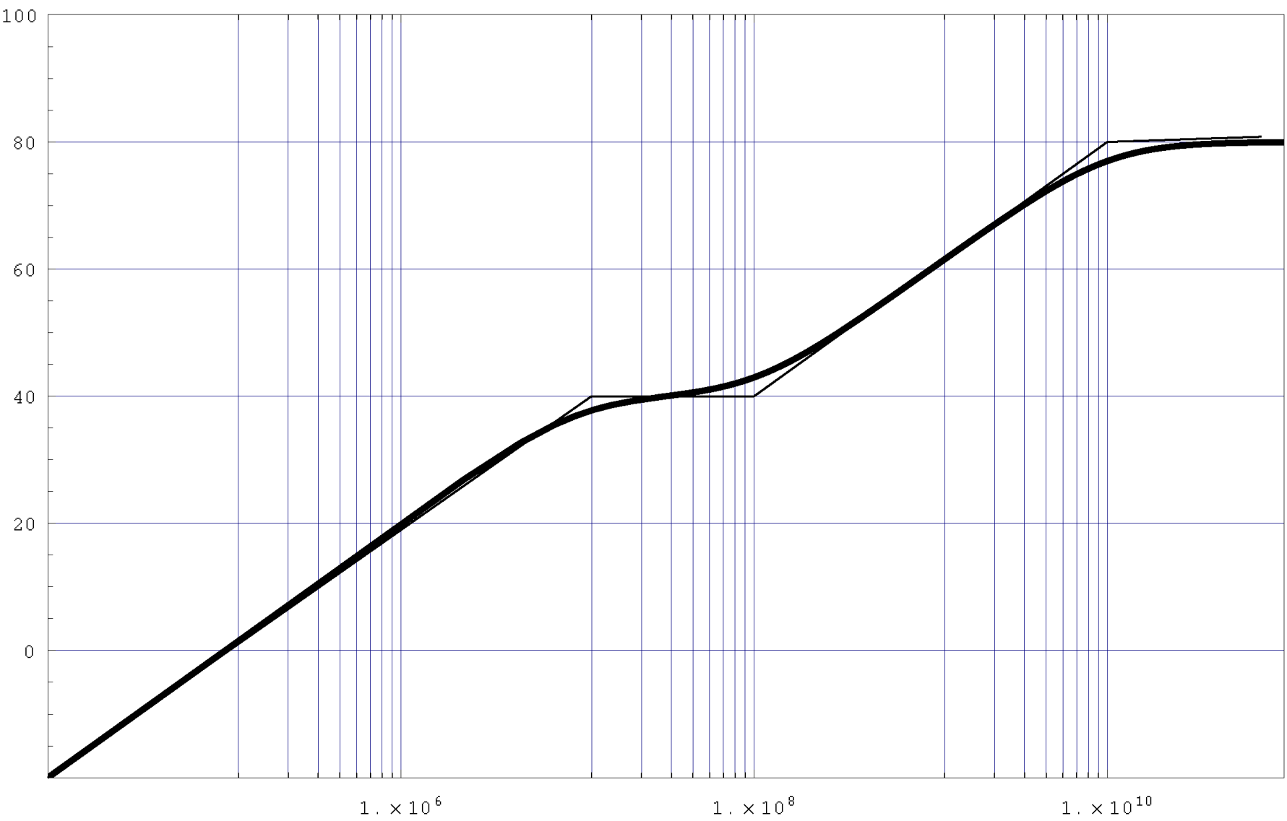
Comparison to “Actual” Mag Plot

Slide 59
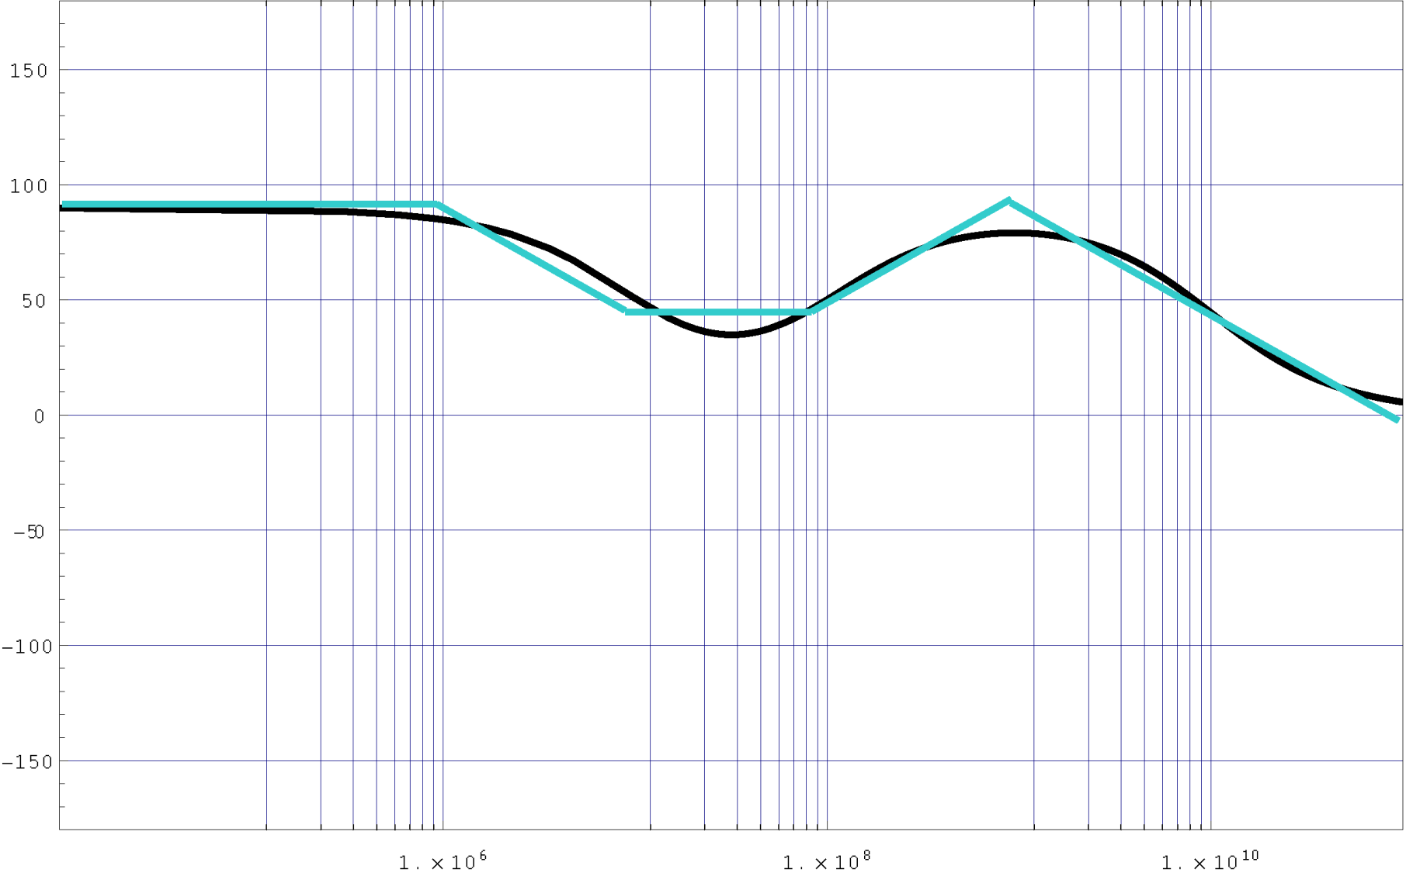
Comparison to “Actual” Phase Plot

Slide 60
1. Stability Analysis using Bode plots

Slide 61
Bode Plot Gain Margin and Phase Margin
With the help of this plot only we can directly comment on the stability of the system without doing any calculations.
Bode plots provides relative stability in terms of gain margin and phase margin.
Gain Margin: Greater will the gain margin greater will be the stability of the system. It refers to the amount of gain, which can be increased or decreased without making the system unstable. It is usually expressed in dB.
Definitions

Slide 62
Phase Margin: Greater will the phase margin greater will be the stability of the system. It refers to the phase which can be increased or decreased without making the system unstable. It is usually expressed in phase.
Gain Cross Over Frequency: It refers to the frequency at which magnitude curve cuts the zero dB axis in the bode plot.
Phase Cross Over Frequency: It refers to the frequency at which phase curve cuts the negative times the 180º axis in this plot.
Definitions
GM/PM tells how much system can tolerate before going unstable!!!

Slide 63
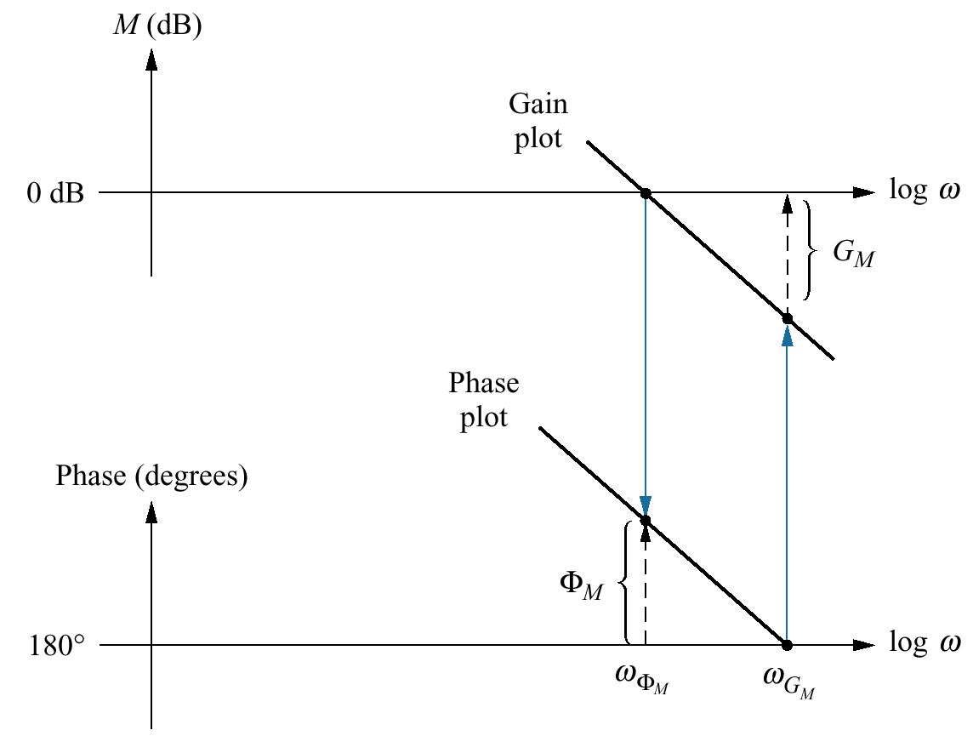
GM and PM via Bode Plot
The frequency at which the magnitude equals 1 is called the gain crossover frequency
The frequency at which the phase equals 180 degrees is called the phase crossover frequency
gain crossover frequency
phase crossover frequency

Slide 64
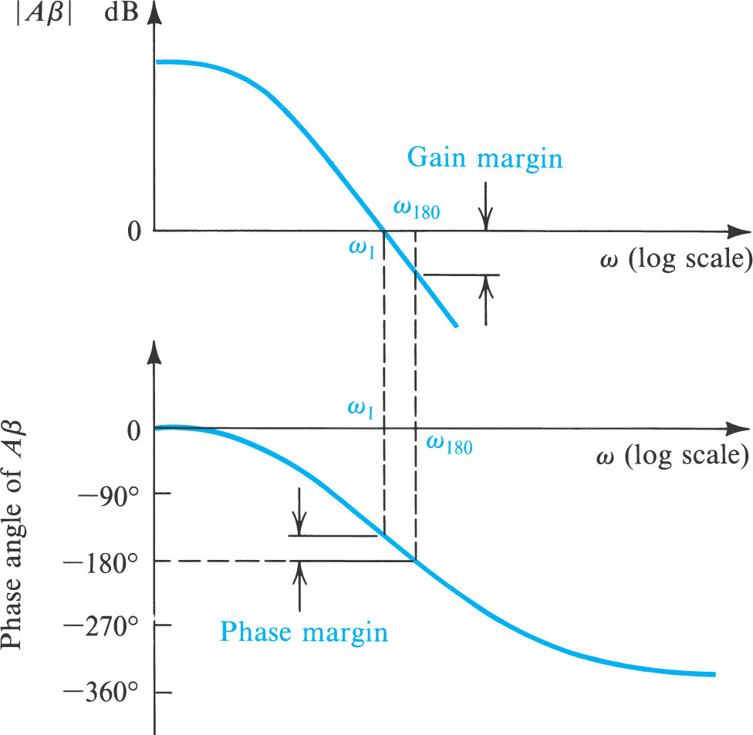

Slide 65
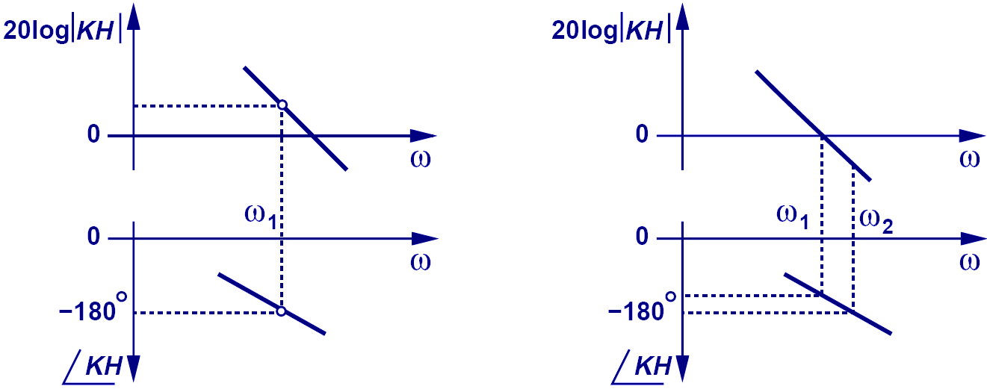
Condition for Oscillation
Although for both systems above, the frequencies at which |KH|=1 and ∠KH=-180º are different, the system on the left is still unstable because at ∠KH=-180º, |KH|>1. Whereas the system on the right is stable because at ∠KH=-180º, |KH|<1.

Slide 66
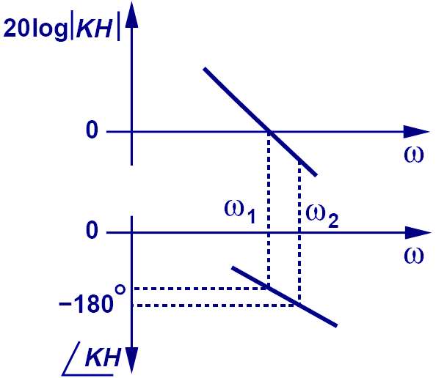
Condition for Stability
ω_{PX}, (“phase crossover”), is the frequency at which ∠KH=-180º.
ω_{GX}, (“gain crossover”), is the frequency at which |KH|=1.

Slide 67
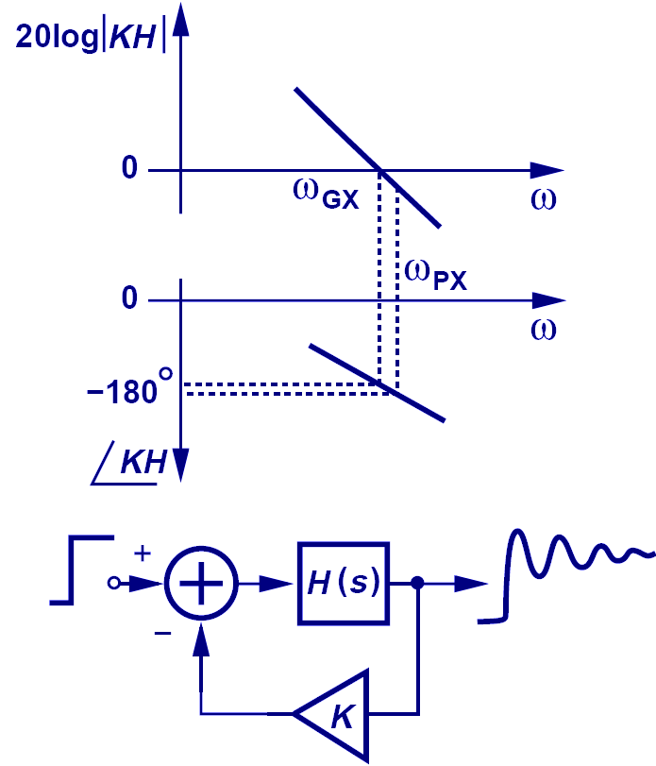

Marginally Stable vs. Stable
Marginally Stable
Stable

Slide 68

Phase Margin Example
Phase Margin = ∠H(ω_{GX})+180
The larger the phase margin, the more stable the negative feedback becomes

Slide 69
2. Stability analysis using Root locus techniques

Slide 70



$$\frac{A}{1+Aβ}$$
Closed loop transfer function =
Characteristic equation =
$$1+Aβ$$
Open loop transfer function =
$$Aβ$$

Slide 71

Transfer function with single pole
By increasing the gain the pole moves to left , towards zero at infinity
Why towards Left (The root locus exists on real axis to left of an odd number of poles and zeros of open loop transfer function, G(s)H(s), that are on the real axis.)
Can have max phase shift of -90

Slide 73
Root Locus

Slide 74
Example:-
$$1+H\left(S\right)G(S)$$
The second order system with the open-loop transfer function
$$For unity gain H\left(S\right)=1$$
$1+ \frac{K}{S (0.5S+1)}$ = 0
-
Closed-loop Transfer function：
Characteristic equation:
Roots of characteristic equation：

Slide 75
Roots：
K | S1 | S2
0 | 0 | -2
0.32 | -0.4 | -1.6
0.5 | -1 | -1
1 | -1+j | -1-j
5 | -1+3j | -1-3j
∞ | -1+∞j | -1-∞j

Slide 76
When k=0,s1=0 and s2=-2 which are the same as open loop poles i.e. when k=0, the closed loop poles are same as open loop poles
When 0<=k<0.5 the poles are real and distinct
When k=0.5 the poles are real and equal.
When k>0.5 the poles are complex conjugates with real part -1
The poles obtained by joining all such pole locations when k is varied from 0 to +∞
The table is represented in graph
The root locus was obtained by joining points obtained from the roots of the characteristic equation

Slide 77
General procedure for plotting a root locus

Slide 78

Rule 1 − Locate the open loop poles and zeros in the ‘s’ plane.
Rule 2 − Find the number of root locus branches.
We know that the root locus branches start at the open loop poles and end at open loop zeros. So, the number of root locus branches N is equal to the number of finite open loop poles P or the number of finite open loop zeros Z, whichever is greater.
Mathematically, we can write the number of root locus branches N as

Slide 79
Rule 3 − Identify and draw the real axis root locus branches.
The root locus exists on real axis to left of an odd number of poles and zeros of open loop transfer function, G(s)H(s), that are on the real axis.)

Slide 80


Slide 81
So, some of the root locus branches approach infinity, when P≠Z. Asymptotes give the direction of these root locus branches. The intersection point of asymptotes on the real axis is known as centroid.
Note: Complex-conjugate pairs of poles and zeros are not counted, since they contribute no net angle to the real axis. If a branch on the real axis lies between a pair of poles, the root locus must break away from the real axis somewhere between the poles

Slide 82



Slide 83


Slide 84


Slide 85



Slide 86

Analogy : Number of roads available for the roots to travel or move , when gain K is increased
$$number of root locus branches N=P=3$$

Slide 87


But there should be 3 root locus branches ; where is 3rd

Slide 88




$$=\frac{0−5−1}{3−0}=−2$$

Slide 89

We will soon see how to calculate these

Slide 90

Now 3 root locus branches

Slide 91

Step-4: Determine the breakaway/break-in point.
The breakaway/break-in point is the point from which the root locus branches leaves/arrives real axis.

Slide 92
Step-4: Determine the breakaway point or break-in point.
The breakaway or break-in points can be determined from the roots
It should be noted that not all the solutions of dK/ds=0 correspond to actual breakaway points.
If a point at which dK/ds=0 is on a root locus, it is an actual breakaway or break-in point.

Slide 93
Step-4: Determine the breakaway point or break-in point.
The characteristic equation of the system is
The breakaway point can now be determined as

Slide 94
Step-4: Determine the breakaway point or break-in point.
Set dK/ds=0 in order to determine breakaway point.

Slide 95
Step-4: Determine the breakaway point or break-in point.
Since the breakaway point needs to be on a root locus between 0 and –1, it is clear that s=–0.4226 corresponds to the actual breakaway point.
Point s=–1.5774 is not on the root locus. Hence, this point is not an actual breakaway or break-in point.

Slide 96
Step-4: Determine the breakaway point.

Slide 97
Step-4: Determine the breakaway point.

Slide 98
Angle of Departure is equal to:
θ_{depart} = 180° + sum(angle to zeros) - sum(angle to poles)
Angle of Departure:
No complex poles in loop gain, so no angles of departure.
Angle of Arrival:
No complex zeros in loop gain, so no angles of arrival.

Slide 99
If there were complex poles or zeros then how to approach the problem?

Slide 100


Slide 101


Slide 102


Slide 103

Example 2
Determine the Breakaway and break_in points

Slide 104
Solution
Differentiating K with respect to s and setting the derivative equal to zero yields;
Hence, solving for s, we find the
break-away and break-in points
s = -1.45 and 3.82

Slide 105

Solution
Break in point
Break out point
-1.45
3.82

Slide 106
EXAMPLES

Slide 107




$$\frac{\left(2q+1\right)180}{P−Z}=; \frac{180}{2}=90 and \frac{540}{2}=270$$
Angle of Asymptotes = $±{90}^{o}$
Centroid = -1.5.

Slide 108


we have 3 poles at s = -2, -3, 0, and we have no zeros.
Intersect of asymptotes is at = -1.67.
Angle of asymptotes, (i.e., ±60° and 180°)

Slide 109


We have n=2 poles at s = 2, -1.
We have zero at s = -3.
Break Out (or Break In) points at s = -6.2, 0.16.

Slide 110



poles at s = -2, -1 ± 1j.
We have finite zero at s = -1.

Slide 111



Slide 112



Slide 113



Slide 114




$$\frac{\left(s+3\right)\left(s−5\right)}{\left(s+1\right)\left(s+3\right)\left(s+5\right)\left(s+7\right)}$$
$$\frac{\left(s+2\right)\left(s−5\right)}{\left(s+1\right)\left(s+3\right)\left(s+5\right)\left(s+7\right)}$$

Slide 115
One positive the other Negative ?
At times it was thought that, if you increase the gain, the system might get unstable and therefore, we must guarantee gain margin.
Nyquist, while working with amplifiers in closed-loop, reduced the gain and was shocked to discover that the system went unstable.
Take the simple open-loop system Go=(s+1)/(s-2) with one unstable pole (in RHP) and one zero in LHP and plot its Root Locus. It is clear that to move the closed-loop pole from the unstable open-loop position towards the stable zero, you must have some sufficiently large positive gain so that the closed-loop pole ends somewhere on the (stable) negative real axis. Now, if you increase the gain, the system will remain stable, so you have an infinite GM from above. Instead, if the gain decreases, the system may again become unstable, so you have some GM from below.
In more complex systems, with many poles and zeros, some closed-loop poles may move with the gain from the unstable RHP region to the stable LHP and then move again to the unstable RHP region for higher gains.

Slide 116
3. Stability analysis using Routh-Hurwitz Stability criteria

Slide 117


Slide 118


Slide 119


Slide 120


Slide 121


Slide 122


Slide 123


Slide 124


Slide 125


Slide 126


Slide 127


Slide 128


Slide 129


Slide 130
Intersection of root locus with the Imaginary axis

Slide 131


Slide 132


Slide 133








Step 1:
Using the standard form , find the characteristic equation CE:$1+G\left(S\right)H\left(S\right)=0$
$$1+ \frac{K}{S\left(S+1\right)\left(S+4\right)}=0$$
$$S^{3}+5S^{2}+4S+K=0$$
Step 2:
$$5S^{2}+20=0$$
Construct Routh table
$$S^{3}$$ | 1 | 4 | 0
$$S^{2}$$ | 5 | K | 0
$$S^{1}$$ | $$\frac{20−K}{5}$$ | 0
$$S^{0}$$ | K | 0
$$S=±2j$$
Auxiliary equation
Select a row except $S^{0} and make it zero by suitably selecting value of K$
$$\frac{20−K}{5}=0 →→→K=20$$

Slide 134
Stability Analysis Using Nyquist Criteria

Slide 135
THE NYQUIST STABILITY CRITERION
A linear closed-loop continuous control system is absolutely stable if the roots of the characteristic equation have negative real parts.
Equivalently, the poles of the closed-loop transfer function, or the zeros of the denominator, 1 + GH(s), of the closed-loop transfer function, must lie in the left-half plane.
The Nyquist Stability Criterion establishes the number of zeros of 1 + GH(s) in the right-half plane directly from the Nyquist Stability Plot of GH(s).

Slide 136

The Nyquist Plot
Note that the radial distance is $\left|Aβ\right|$and the angle is the phase Angle $φ$.
The Nyquist plot intersects the negative real axis at the frequency $ω_{180}$. Thus, if this intersection occurs to the left of the point (–1, 0), we know that the magnitude of loop gain at this frequency is greater than unity and the amplifier will be unstable.
On the other hand, if the intersection occurs to the right of the point (–1, 0) the amplifier will be stable. It follows that if the Nyquist plot encircles the point (–1, 0) then the amplifier will be unstable.

Slide 137


Slide 138


Slide 139
Compensators

Slide 140



Analogous Electrical and Mechanical Systems
Conversion from Electrical to Mechanical and vice versa

Slide 141
Introduction
If a system is unstable
It is then required to reconsider the structure of the system and redesign the system.
The design problems, therefore, become those of improving system performance by insertion of a compensator.
Compensator: A compensator is an additional component or circuit that is inserted into a control system to equalize or compensate for a deficient performance.

Slide 142
Introduction
Necessities of compensation
A system may be unsatisfactory in：
Stability.
Speed of response.
Steady-state error.
Thus the design of a system is concerned with the alteration of the frequency response or the root locus of the system in order to obtain a suitable system performance.

Slide 143
Compensation via Root Locus
Performance measures in the time domain:
Peak time;
Overshoot;
Settling time for a step input;
Steady-state error for test inputs
These performance specifications can be defined in terms of the desirable location of the poles and zeros of the closed-loop.
Root locus method can be used to find a suitable compensator G_{c}(s) so that the resultant root locus results in the desired closed-loop root configuration.

Slide 144
Compensation via Root Locus
The design by the root-locus method is based on reshaping the root locus of the system by adding poles and zeros to the system’s open-loop transfer function and forcing the root loci to pass through desired closed-loop poles in the s plane.
The characteristic of the root-locus design is its being based on the assumption that the closed-loop system has a pair of dominant closed-loop poles.
This means that the effects of zeros and additional poles do not affect the response characteristics very much.

Slide 145


Compensator Configurations
Compensation schemes commonly used for feedback control systems are:
Series Compensation
Parallel Compensation

Slide 146
Compensator Configurations
The choice between series compensation and parallel compensation depends on
the nature of the signals
the power levels at various points
available components
the designer’s experience
economic considerations and so on.

Slide 147
Commonly Used Compensators
Among the many kinds of compensators, widely employed compensators are the
lead compensators
lag compensators
lag–lead compensators

Slide 148
Commonly Used Compensators
lag–lead compensators
In a lag–lead network, both phase lag and phase lead occur in the output but in different frequency regions.
Phase lag occurs in the low-frequency region and phase lead occurs in the high-frequency region.

Slide 149
Compensators
Using root locus techniques, we have seen how the pole positions of a closed loop can be adjusted by varying a parameter

Slide 150

Closed Loop Designed Using Root Locus

Slide 151
General Effect of Addition of Poles

Slide 152
General Effect of Addition of Zeros

Slide 153
Effect of Addition of Poles on Root Locus
The addition of a pole to the open-loop transfer function has the effect of pulling the root locus to the right, tending to lower the system’s relative stability and to slow down the settling of the response.

Slide 154
Effect of Addition of poles
Add a Pole at -1

Slide 155
Effect of Addition of poles

Slide 156
Effect of Addition of Zeros on Root Locus
The addition of a zero to the open-loop transfer function has the effect of pulling the root locus to the left, tending to make the system more stable and to speed up the settling of the response.
Physically, the addition of a zero in the feed forward transfer function means the addition of derivative control to the system.
The effect of such control is to introduce a degree of anticipation into the system and speed up the transient response.

Slide 157
Effect of Addition of zeros
Add a zero at -3

Slide 158
Effect of Addition of zeros
Add a zero at -3
Continued…..

Slide 159
Some Remarks

Slide 160
Lead/Lag Compensation
Lead/Lag compensation is very similar to PD/PI, or PID control.
The lead compensator plays the same role as the PD controller, reshaping the root locus to improve the transient response.
Lag and PI compensation are similar and have the same response: to improve the steady state accuracy of the closed-loop system.
Both PID and lead/lag compensation can be used successfully, and can be combined.

Slide 161
Lead and Lag Compensator

Slide 162

Lag Compensator
uncompensated:
original
compensated:
added pole and zero

Slide 163
Lag Compensator a. Type 1 uncompensated system; b. Type 1 compensated system; c. compensator pole-zero plot

Slide 164


Lead Compensator

Slide 165


Slide 168

Proportional + Derivative (PD)

Slide 169

Proportional + Integral+ Derivative (PID)

